Slide 1
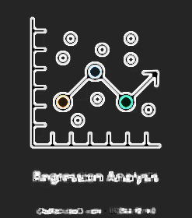

FOOD DEMAND FORECAST REGRESSION
By Prachi Chaubal, Jordan Michaels and Luke Policke

Slide 2

Introduction – the why
For our project, we are looking to forecast and predict the future sales of a meal delivery company. These sales are based on the different locations the company possesses, how popular they are in these locations, and how much their services are needed by the people in their retrospective markets.
Our work will display the regression analysis of Italian Cuisine, Thai Cuisine, Indian Cuisine, and Continental Cuisine all through work done in excel. This data will then be used to predict the future sales of the company in order for them to stock their raw materials accordingly.

Slide 3

Review of Literature
meal delivery company, multiple locations in different cities
within these cities, multiple fulfillment locations
needs our help predicting amount needed for future stock to make sure they have enough raw materials for their customers
important to note the raw material is perishable, time is of the essence
predict the next 10 weeks of stock

Slide 4


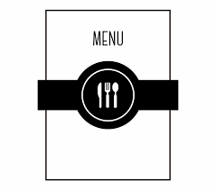




Factors – Independent Variables
Price
Location
Menu
Out of stock
Seasonality
Quality of service
Preference

Slide 5

Dependent Variables
Number of orders in all the centers

Slide 6
Data and Source Description
It is a ‘Meal Delivery Company’.
Operates in multiple cities in U.S.
Have various fulfillment centers.
ID | Week | Center ID | Meal ID | Checkout price | Number of Orders
1379560 | 1 | 55 | 1885 | 136.83 | 177
1466964 | 1 | 55 | 1993 | 136.83 | 270
1346989 | 1 | 55 | 2539 | 134.86 | 189
1338232 | 1 | 55 | 2139 | 339.5 | 54
1448490 | 1 | 55 | 2631 | 243.5 | 40
1270037 | 1 | 55 | 1248 | 251.23 | 28
1191377 | 1 | 55 | 1778 | 183.36 | 190
1499955 | 1 | 55 | 1062 | 182.36 | 391
1025244 | 1 | 55 | 2707 | 193.06 | 472
1054194 | 1 | 55 | 1207 | 325.92 | 676
1469367 | 1 | 55 | 1230 | 323.01 | 823
1029333 | 1 | 55 | 2322 | 322.07 | 972
1446016 | 1 | 55 | 2290 | 311.43 | 162
1244647 | 1 | 55 | 1727 | 445.23 | 420
1378227 | 1 | 55 | 1109 | 264.84 | 756
1181556 | 1 | 55 | 2640 | 282.33 | 108
1313873 | 1 | 55 | 2306 | 243.5 | 28
1067069 | 1 | 55 | 2126 | 486 | 28
1058482 | 1 | 55 | 2826 | 306.58 | 188
1240935 | 1 | 55 | 1754 | 289.12 | 485
1044821 | 1 | 55 | 1971 | 259.99 | 798
1149039 | 1 | 55 | 1902 | 388.03 | 14
Meal ID | Category | Cuisine
1885 | Beverages | Thai
1993 | Beverages | Thai
2539 | Beverages | Thai
1248 | Beverages | Indian
2631 | Beverages | Indian
1311 | Extras | Thai
1062 | Beverages | Italian
1778 | Beverages | Italian
1803 | Extras | Thai
1198 | Extras | Thai
2707 | Beverages | Italian
1847 | Soup | Thai
1438 | Soup | Thai
2494 | Soup | Thai
2760 | Other Snacks | Thai
2490 | Salad | Italian
1109 | Rice Bowl | Indian
2290 | Rice Bowl | Indian
1525 | Other Snacks | Thai

Slide 7


ITALIAN CUISINE

Slide 8
Italian cuisine demand forecast- Regression statistics
Regression formula y = bx+ a
Correlation Coefficient
b (Slope of a regression line)
Y - Intercept (a):
Regression Statistics
-1.1573
570.49
Multiple R | 0.54
R Square | 0.29
Adjusted R Square | 0.28
Standard Error | 145.11
Observations | 57
570.49
-1.1573
-0.5421
 | Coefficients | Standard Error | t-Stat | P-value
Intercept | 573.37 | 76.40 | 7.50 | 5.61
190.12 | -1.17 | 0.25 | -4.74 | 1.56

Slide 9


THAI CUISINE

Slide 10
Thai cuisine demand forecast- Regression statistics
Regression formula y = bx+ a
Correlation Coefficient
b (Slope of a regression line)
Y - Intercept (a):
Regression Statistics
-1.417
526.10
Multiple R | 0.48
R Square | 0.22
Adjusted R Square | 0.21
Standard Error | 161.46
Observations | 74
526.10
-1.4173
-0.4803
 | Coefficients | Standard Error | t-Stat | P-value
Intercept | 480.72 | 64.72 | 7.42 | 1.79
150.35 | -1.26 | 0.27 | -4.63 | 1.54

Slide 11

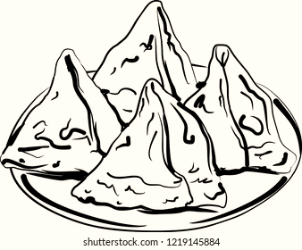
INDIAN CUISINE

Slide 12
Indian cuisine demand forecast- Regression statistics
Regression formula y = bx+ a
Correlation Coefficient
b (Slope of a regression line)
Y - Intercept (a):
Regression Statistics
-0.322
259.81
Multiple R | 0.22
R Square | 0.05
Adjusted R Square | 0.03
Standard Error | 174.40
Observations | 53
259.81
-0.322
-0.220
 | Coefficients | Standard Error | t-Stat | P-value
Intercept | 263.82 | 74.57 | 3.54 | 0.008
292.03 | -0.32 | 0.19 | -1.65 | 0.10

Slide 13


CONTINENTAL CUISINE

Slide 14
Continental cuisine demand forecast- Regression statistics
Regression formula y = bx+ a
Correlation Coefficient
b (Slope of a regression line)
Y - Intercept (a):
Regression Statistics
-0.412
357.06
Multiple R | 0.26
R Square | 0.07
Adjusted R Square | 0.05
Standard Error | 188.08
Observations | 59
357.06
-0.412
-0.254
 | Coefficients | Standard Error | t-Stat | P-value
Intercept | 373.45 | 114.58 | 3.26 | 0.009
388 | -0.44 | 0.21 | -2.09 | 0.041

Slide 15

Conclusion
Regression analysis on the provided data in Excel demonstrated that larger orders were placed when prices between lower and moderate levels than, exceeding these levels.
To predict future sales figures with greater accuracy, more criteria must be considered in addition to price, such as location, branding, quality, preferences, and so forth.

Slide 16

THANK YOU

